Slide 1
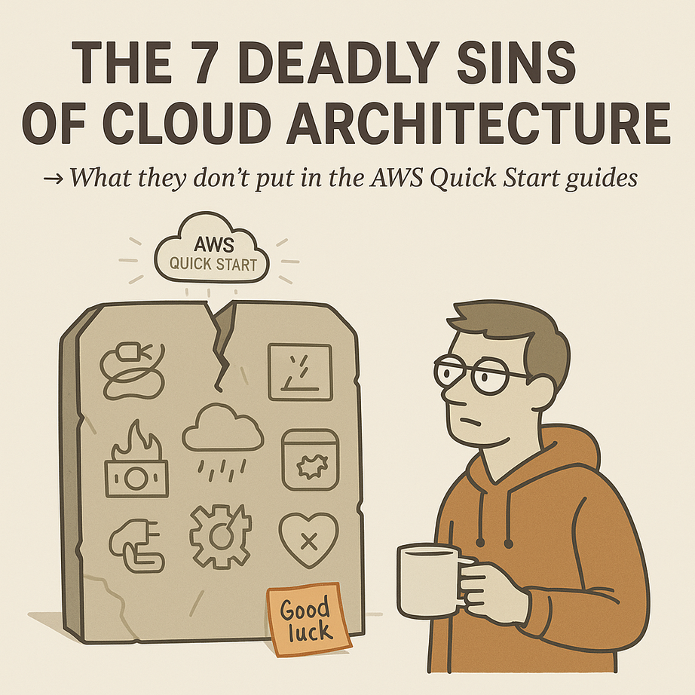

7 Pitfalls of Cloud Architecture
What they don’t put in the AWS Quick Start guides
Craig Bensemann

Slide 2

The Problem
Cloud promises scale and flexibility
What we get: surprise bills, black-box failures
Aaron Loeb
Alfredo Torres
Juliana Silva

Slide 3


CLOUD BY CHECKBOX
Using services to satisfy a contract, not a design

Slide 4
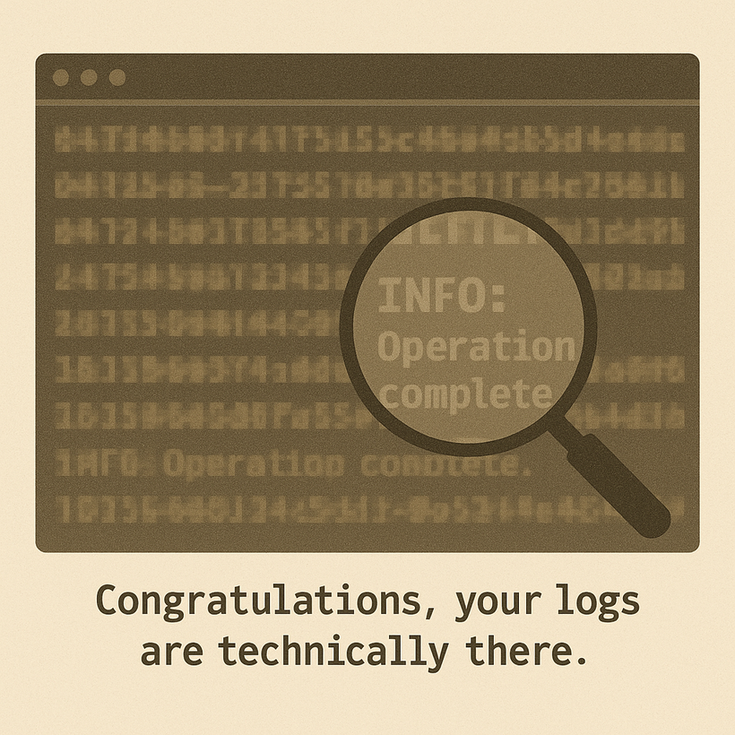
CloudWatch Is Not Observability
  Expensive
  Slow
  Hard to search

Slide 5

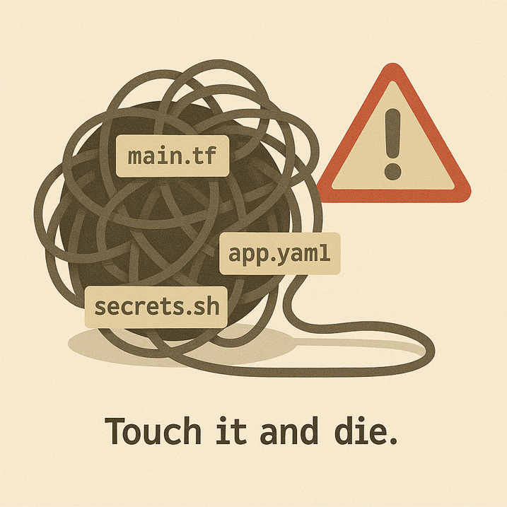
Infrastructure Entropy
01
Infrastructure and application code mixed deployments
02
Manual Database migrations
03
Configuration/Deployment by Human
04
Deployments that aren’t Idempotent

Slide 6
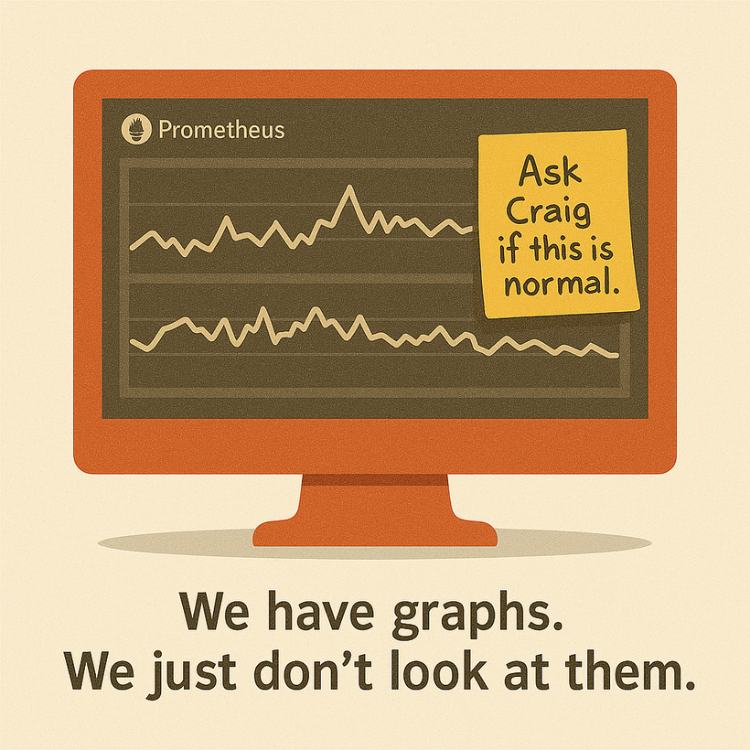
Monitoring as an afterthought
Metrics don’t matter if no one sees them
  Prometheus added late, barely hooked in
  Dashboards ignored until things burn
  Alerts are noise without ownership

Slide 7
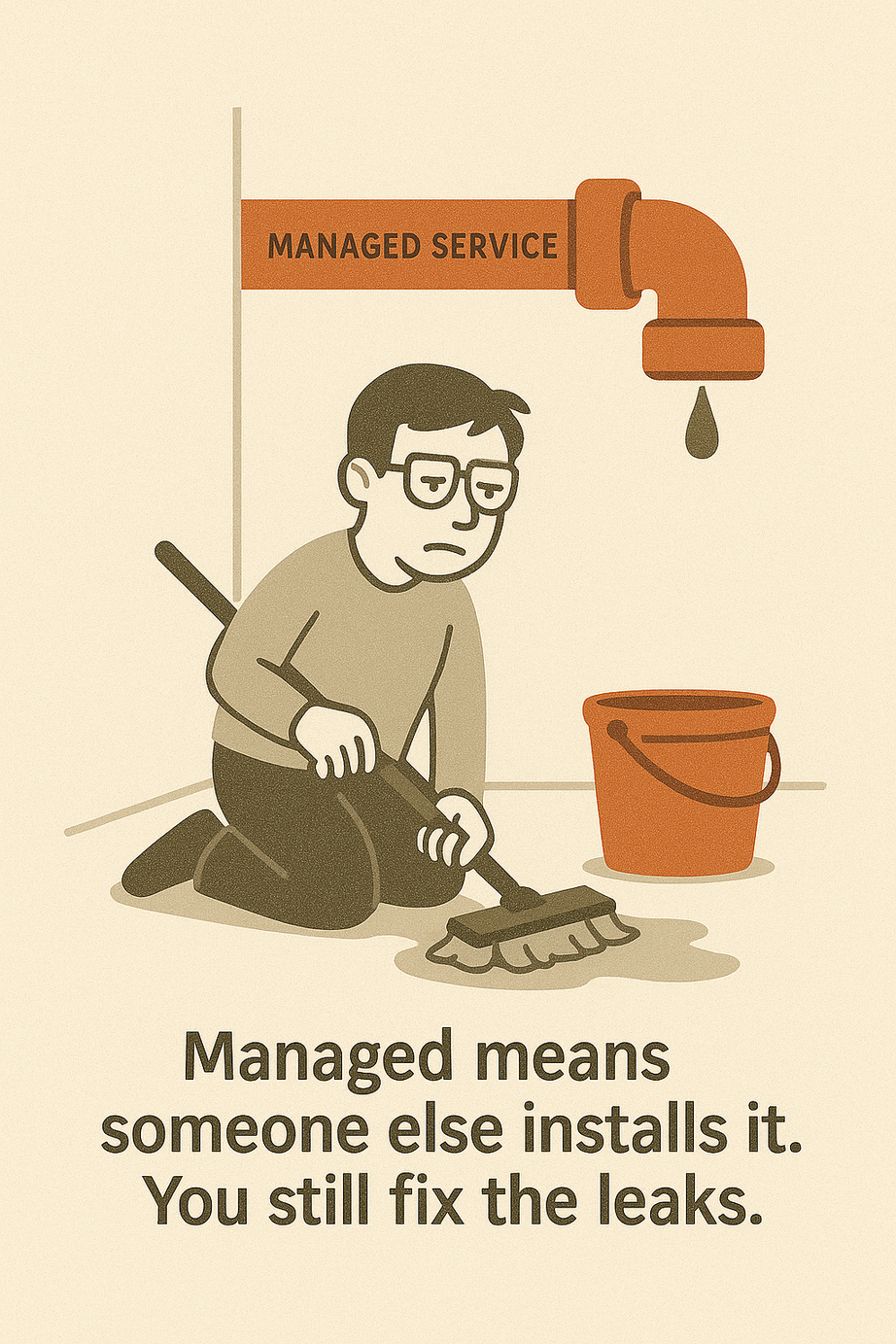
The Myth of Managed
Managed services ≠ fewer people
  You move to the cloud to save ops
  Now you need an ECS specialist, a Lambda whisperer, and a Kafka babysitter
  Abstraction becomes overhead

Slide 8

Cost Without Value
01
Using the wrong service for your task
02
Storing all the things...forever
03
Using managed services
04
Lift and Shift mentality

Slide 9

Serverless, Not Simplified
  Arbitrary limits
  Hard to reason about data flow
  Limited debugging
Lambda

Slide 10

What these pitfalls have in common
  💸 Budget: Infra, data, tool sprawl
  🧠 Mental load: Debugging, fear of change
  ❤️ Morale: Hero culture, burnout
  🧭 Clarity: Lost in translation between teams and services

Slide 11

Patterns for Success
Flow
Logs
GitOps
Infrastructure
Cost

Slide 12

Bonus: Respect the Humans
“Your team is your platform.”
  Clarity reduces stress
  Bad systems create blame loops
  Most real ops wins come from people, not services

Slide 13
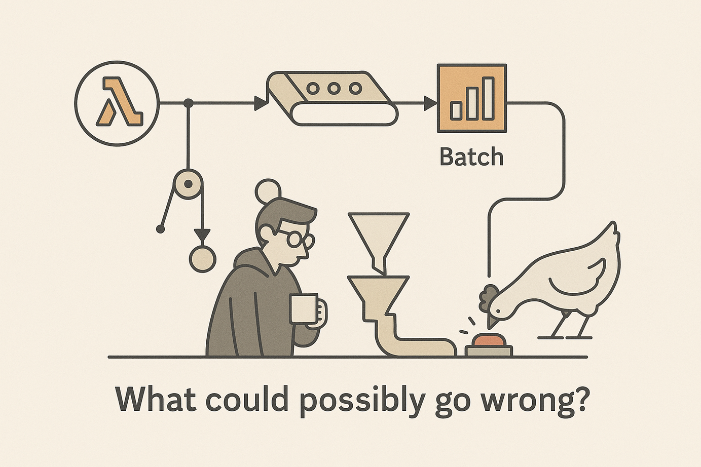
CLOSING THOUGHT
"The best cloud system is the one you can explain at 2AM."
  Make intentional choices
  Design for observability
  Value clarity over cleverness
  And trust your team

Slide 14
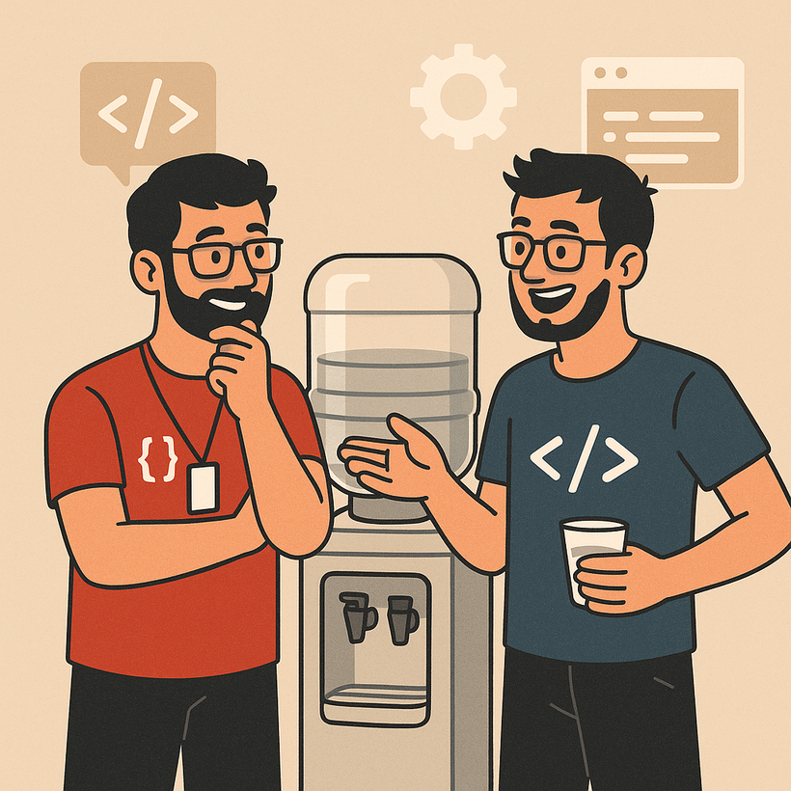
Questions & Confessions

Slide 15





CONNECT
thecynical.dev/slides
craig@thecynical.dev
craigbensemann

